Slide 1
Quantifying the Extent of Disease
CHAPTER 3

Slide 2
Learning Objectives
Define and differentiate prevalence and incidence
Select, compute, and interpret the appropriate measure to compare the extent of disease between groups
Compare and contrast relative risks, risk differences, and odds ratios
Compute and interpret relative risks, risk differences, and odds ratios

Slide 3
Critical Components of RCT
Randomization
Control group – ethical issues
Monitoring
Interim analysis
Data and safety monitoring board
Data management
Reporting

Slide 4
Prevalence
Proportion of participants with disease at a particular point in time

Slide 5
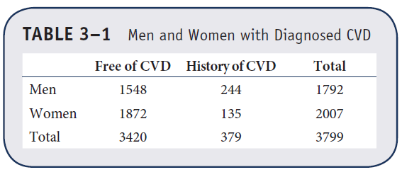
Example 3.1. Computing Prevalence
Prevalence of CVD = 379/3799 = 0.0998 = 9.98%
Prevalence of CVD in Men = 244/1792 = 0.1362 = 13.62%
Prevalence of CVD in Women = 135/2007 = 0.0673 = 6.73%

Slide 6
Example: H1N1 Outbreak
H1N1 outbreak first noticed in Mexico.
Large outbreak early on in La Gloria—a small village outside of Mexico City
Studied extensively in the first report on H1N1 (Fraser, Donelly, et al. “Pandemic potential of a strain of Influenza (H1N1): Early findings,” Science Express, 11 May 2009.)
Important questions
Who is most likely to be impacted?
What are characteristics of people commonly impacted?

Slide 7
Computing Prevalence (1 of 2)
Data on H1N1 outbreak in La Gloria, Mexico: n = 1575 villagers (out of 2155) were surveyed to determine if they had influenza-like illness (ILI) between 2/15/09 and 4/27/09.
Age | No ILI | ILI | Total
≤ 44 years | 703 | 522 | 1225
> 44 years | 256 | 94 | 350
Total | 959 | 616 | 1575

Slide 8
Computing Prevalence (2 of 2)
Age | No ILI | ILI | Total
≤ 44 years | 703 | 522 | 1225
> 44 years | 256 | 94 | 350
Total | 959 | 616 | 1575
Prevalence of ILI = 616/1575 = 0.3911 = 39.11%
Prevalence of ILI in ≤ 44 = 522/1225 = 0.4261 = 42.61%
Prevalence of ILI in > 44 = 94/350 = 0.2686 = 26.86%

Slide 9
Incidence
Likelihood of developing disease among persons free of disease who are at risk of developing disease

Slide 10
Computing Incidence
Cumulative incidence requires complete follow-up on all participants.
Person-time data is used to take full advantage of available information in incidence rate.
Incidence rate often expressed as an integer per multiple of participants over a specified time.

Slide 11
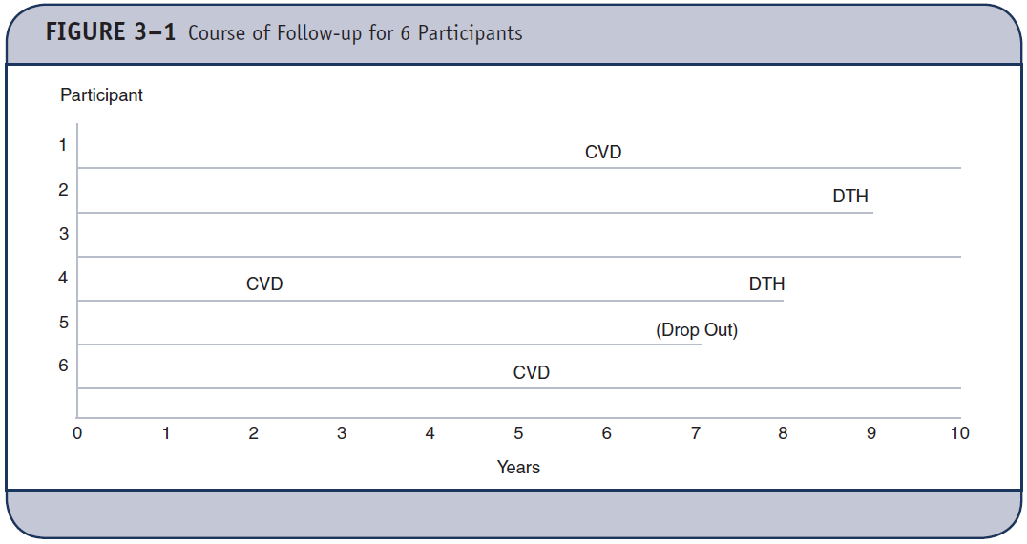
Incidence of CVD?

Slide 12
Incidence Rate

Slide 13
Incidence of CVD
Incidence = 2/(6 + 9 + 10 + 2 + 7 + 5) = 3/39 = 0.0769
7.7 per 100 person-years
Incidence rate (IR) of death per person-year
Incidence = 2/(10 + 9 + 10 + 8 + 7 + 10) = 2/54 = 0.037
3.7 deaths per 100 person-years

Slide 14
Example 3.2. Computing Incidence
 | Develop CVD | Total Follow-Up Time (years)
Men | 190 | 9984
Women | 119 | 12153
Total | 309 | 22137
Incidence Rate of CVD in Men = 190/9984 = 0.01903
= 190 per 10,000 person-years
Incidence Rate of CVD in Women = 119/12153 = 0.00979
= 98 per 10,000 person-years

Slide 15
Computing Incidence
 | Developed ILI | Total Follow-Up Time (years)
≤ 44 years | 522 | 20,064
> 44 years | 94 | 3,514
Total | 616 | 23,578
Incidence Rate of ILI in ≤ 44 = 522/20,064 = 0.0260
= 260 per 10,000 person-years
Incidence Rate of ILI in > 44 = 94/3514 = 0.0268
= 268 per 10,000 person-years

Slide 16
Comparing Extent of Disease Between Groups (1 of 2)
Risk difference (excess risk)

Slide 17
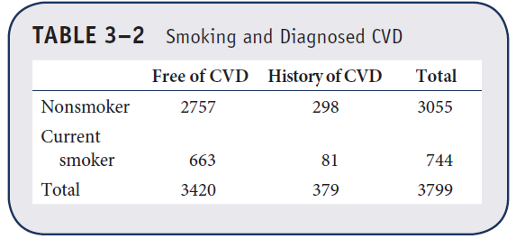
Comparing Extent of Disease Between Groups (2 of 2)
Risk difference of prevalent CVD in smokers versus nonsmokers
= 81/744 – 298/3055 = 0.1089 – 0.0975 = 0.0114

Slide 18
Population Attributable Risk of CVD in Smokers vs. Nonsmokers
= (0.0998 – 0.0975) / 0.0998 = 0.023 = 2.3%

Slide 19
Comparing Extent of Disease Between Groups (1 of 7)
Risk difference of history of ILI in males and females in La Gloria
 | No ILI | ILI | Total
Males | 517 | 260 | 777
Females | 442 | 356 | 798
Total | 959 | 616 | 1575
= 356/798 – 260/777 = 0.4461 – 0.3346 = 0.1115

Slide 20
Comparing Extent of Disease Between Groups (2 of 7)
Relative risk

Slide 21
Comparing Extent of Disease Between Groups (3 of 7)
Relative risk of CVD in smokers versus nonsmokers
= 0.1089/0.0975 = 1.12

Slide 22
Comparing Extent of Disease Between Groups (4 of 7)
Relative risk of ILI in females versus males
 | No ILI | ILI | Total
Males | 517 | 260 | 777
Females | 442 | 356 | 798
 | 959 | 616 | 1575
= 0.4461/0.3346 = 1.33

Slide 23
Comparing Extent of Disease Between Groups (5 of 7)
Odds ratio

Slide 24
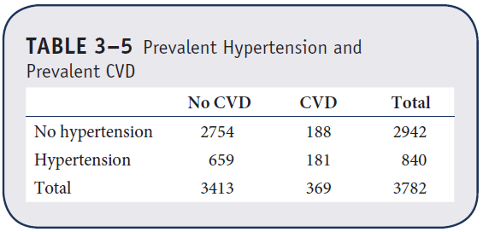
Comparing Extent of Disease Between Groups (6 of 7)
Odds ratio of CVD in hypertensives versus hypertensives

Slide 25
Comparing Extent of Disease Between Groups (7 of 7)
Odds ratio of ILI in younger group versus older group
Age | No ILI | ILI | Total
≤ 44 years | 703 | 522 | 1225
> 44 years | 256 | 94 | 350
Total | 959 | 616 | 1575

Slide 26
Relative Risks and Odds Ratios
Not possible to estimate relative risk in case-control studies
Possible to estimate odds ratio because of its invariance property

Slide 27
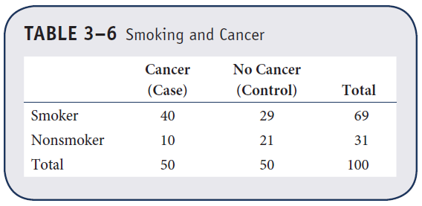
Invariance Property of Odds Ratio (1 of 2)
Case-control study to assess association between smoking and cancer

Slide 28
Invariance Property of Odds Ratio (2 of 2)
Odds ratio for cancer in smokers versus nonsmokers
= (40/29) / (10/21) = 2.90
Odds of smoking in patients with cancer versus not
= (40/10) / (29/21) = 2.90(!)

